Slide 1

Determining the relationship between the letters in the Voynich manuscript splitting the text into parts
20th Mexican International Conference on Artificial Intelligence
AUTHORS:
Esbolat Sapargali
Iskander Akhmetov
Alexandr Pak
Alexander Gelbukh

Slide 2
TABLE OF CONTENTS
INTRODUCTION
DATA PREPARATION
MODEL ARCHITECTURE
CONCLUSION

Slide 3
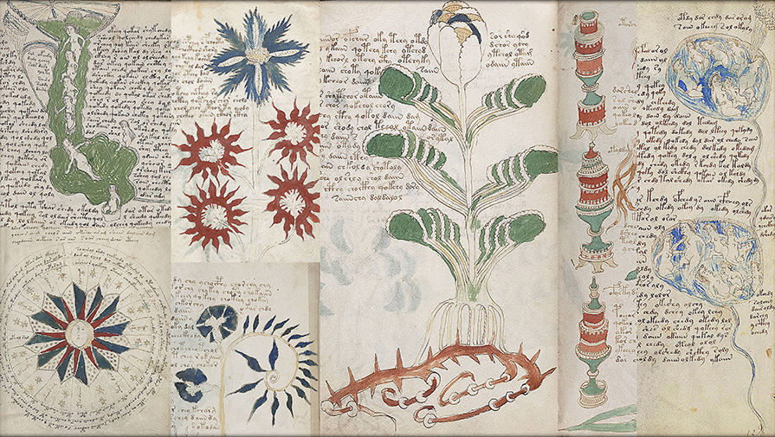
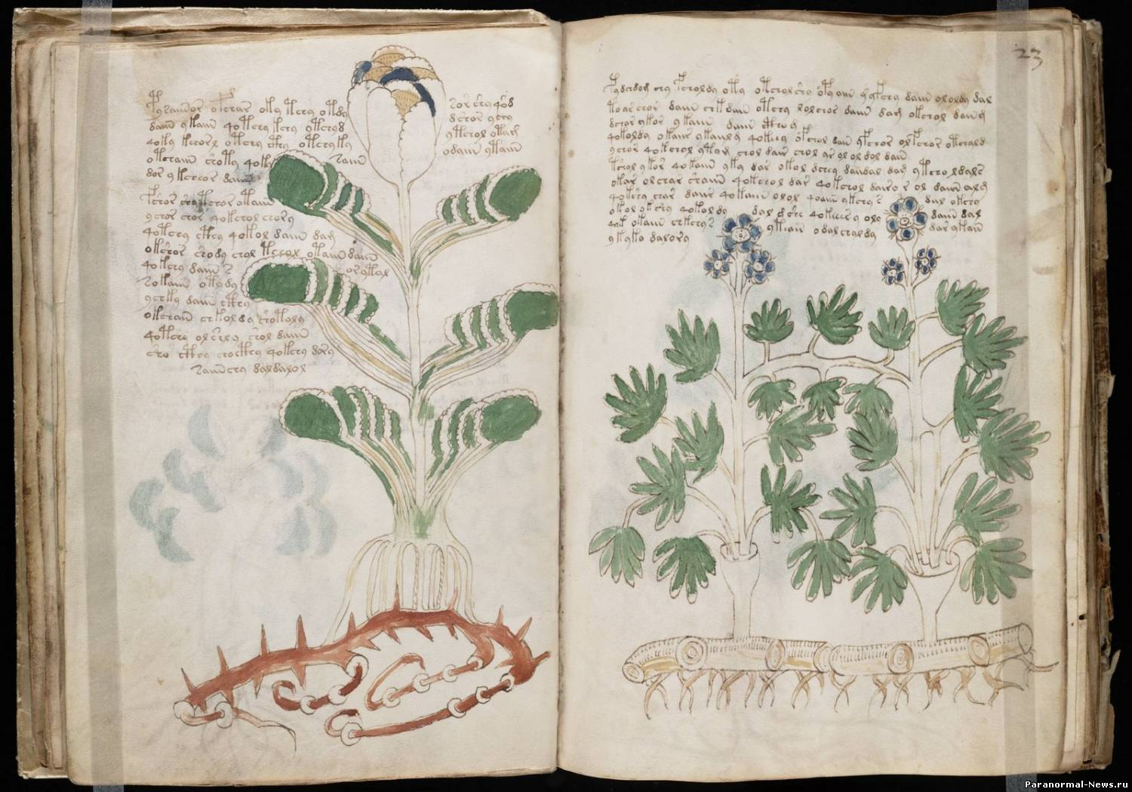
INTRODUCTION

Slide 4
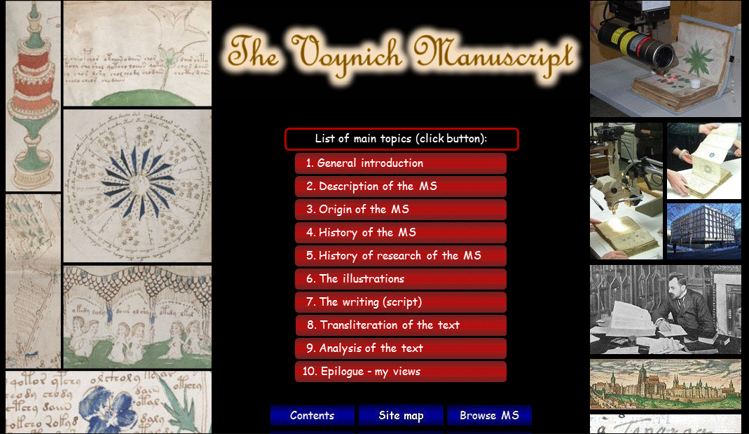
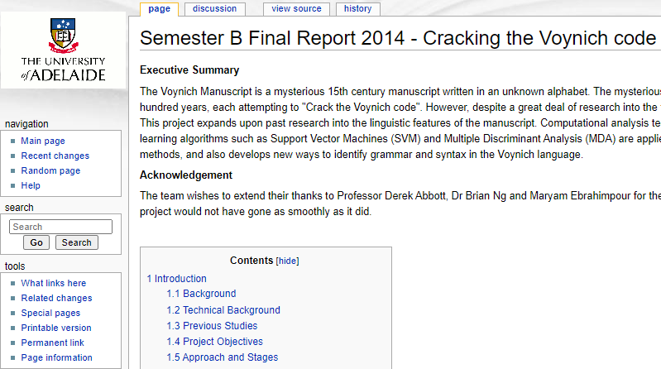
previous research related to the manuscript and their achievements

Slide 5

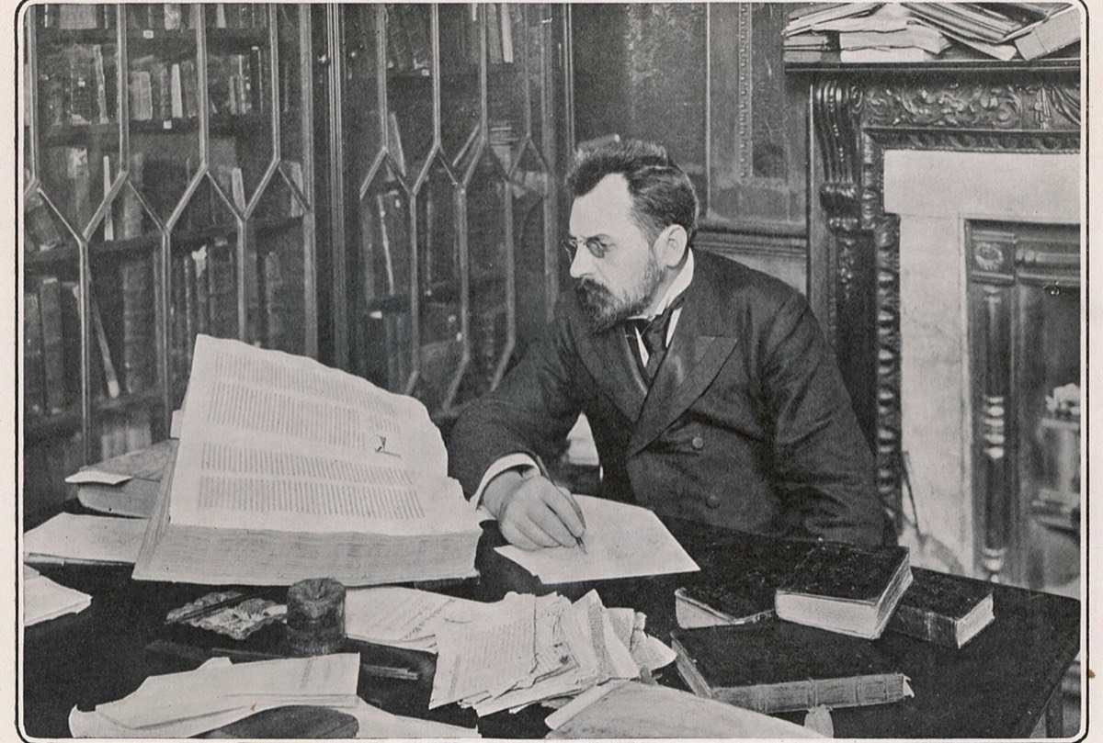
problems and difficulties associated with the manuscript

Slide 6
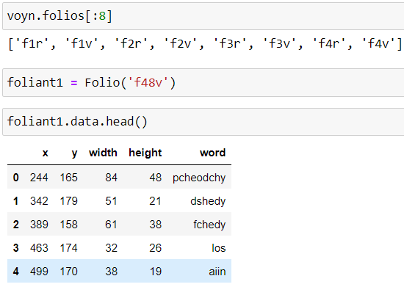
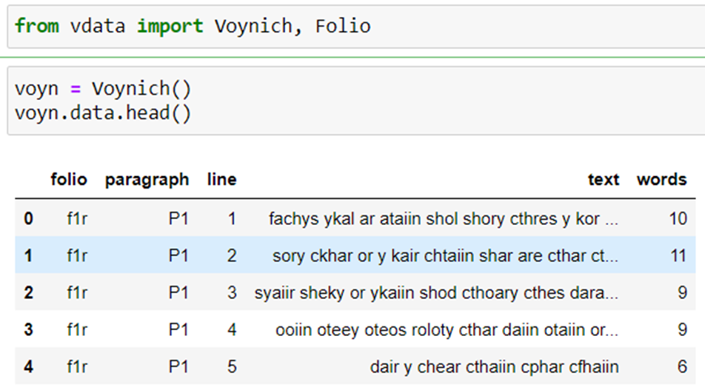
folium (leaf)

Slide 7
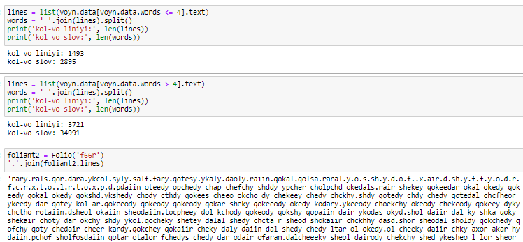
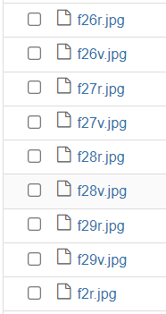
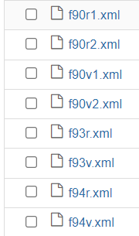
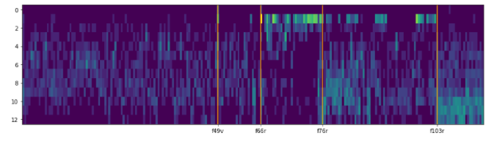
Data preparation
counting words;
data conversion;
marking.

Slide 8
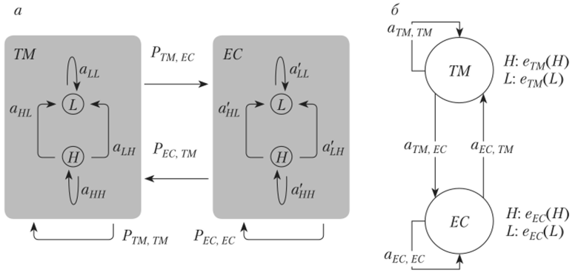
MODEL ARCHITECTURE
HIDDEN MARKOV MODEL

Slide 9
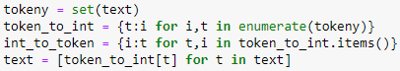
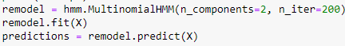
HMMLEARN
hmmlearn implements Hidden Markov Models. Hidden Markov Model with multinomial (discrete) emissions.
n_components (int) – Number of states.
n_iter (int, optional) – Maximum number of iterations to perform.

Slide 10
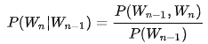
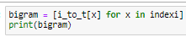
BIGRAM
A bigram is a sequence of two adjacent elements from a string of tokens, usually representing letters, syllables or words. A bigram is an n-gram for n = 2. The frequency distribution of each bigram in a string is usually used for simple statistical analysis of text, including computational linguistics.

Slide 11
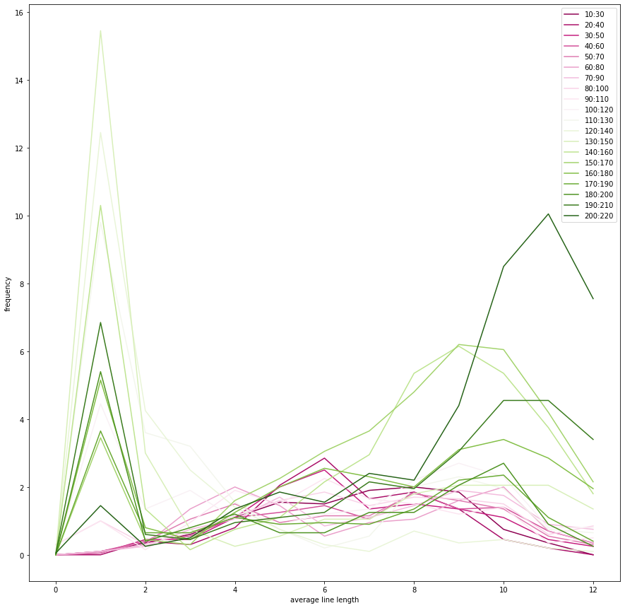
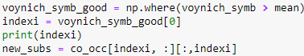
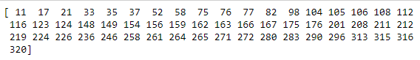
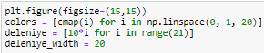
Results

Slide 12
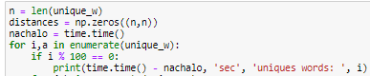
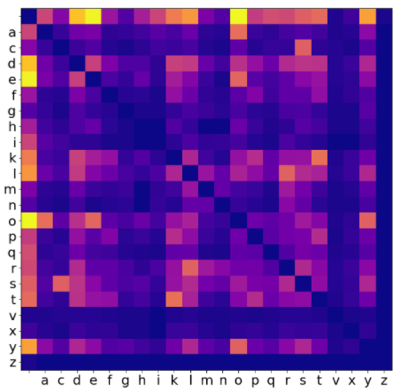
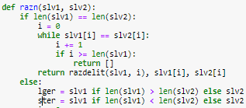
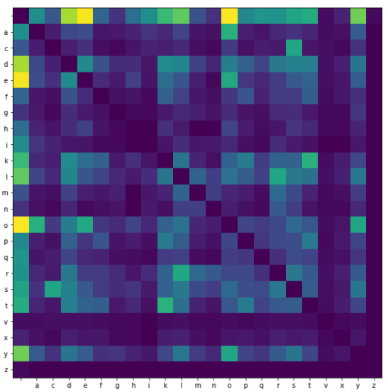
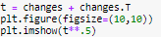
Results

Slide 13
CONCLUSION
The Folio Integrity Check function, on several attempts at checking, has shown that they match. The number of unique words (8078 out of 37886) was determined.
Loss of vowels between consonants will be 0, only consonants or vowels will be 0.1. 5.5%, when you go to state 2, you will see other words.
Some letters (d) are replaced with each other with higher frequency than others.

Slide 14
Next researcher can create a function to match the format of the input (browsing directories, parsing extensible markup language).
To obtain new lists of tokens in each document, the input data can be analysed, also the tokens can be converted to folders into identifiers and output inside the repetition with the resulting sparse vector.
Letter patterns from frequency and length were determined by words, including the presence of certain letters in English (the appearance of consonants and vowels)

Slide 15
thank you for your attention

